Slide 1

Sephora Beauty Products
S. Jai Harish
CB.EN.P2AIE22013
Dr.Mansi Sharma

Slide 2

Introduction
Sephora is a well-known multinational beauty retailer that offers a wide range of cosmetic, skincare, haircare, and fragrance products.
Sephora carries an extensive selection of products from various renowned brands, as well as its own private label products.
They provide a wide range of products suitable for diverse skin tones, hair textures, and personal preferences. Sephora also emphasizes clean beauty, offering products that are formulated without certain ingredients, cruelty-free, or vegan.
Sephora has both physical retail stores and an online platform, making it convenient for customers to explore and purchase products. Sephora also offers beauty services such as makeovers, consultations, and classes to enhance the overall shopping experience
The store features a diverse range of cosmetics, including foundations, concealers, blushes, eye shadows, lipsticks, and more. Skincare products available at Sephora cater to different skin types and concerns, such as cleansers, moisturizers, serums, masks, and sunscreens.
Sephora offers Haircare products for various hair types and Fragrances for both men and women are also part of their product offerings, featuring perfumes, colognes, and body sprays.

Slide 3
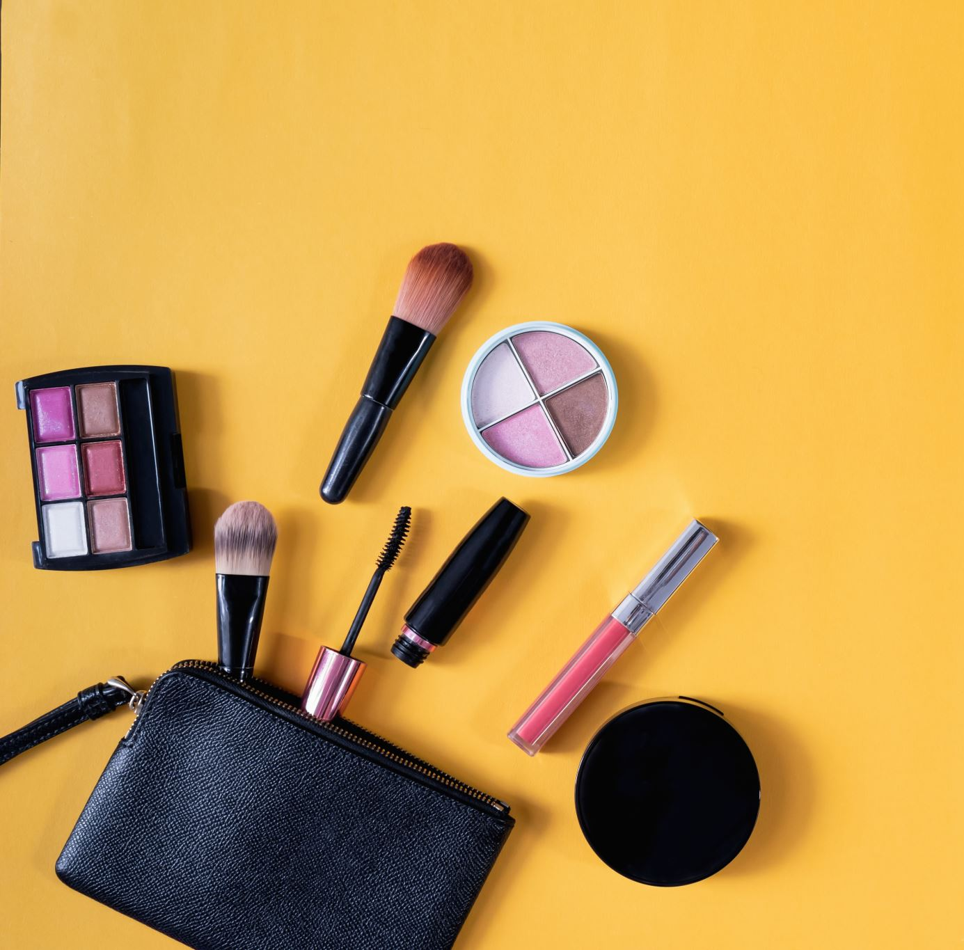
Problem Statement
As we seen they offer various products Sephora Collection, and includes beauty products such as cosmetics, skincare, body, fragrance, nail color, beauty tools, body lotions and haircare
They often provide detailed product descriptions, customer reviews, and tutorials to help customers make informed decisions.
As a Data Scientist we need to explore the data, and find popular brand name and what are all their main category of product, subsequently find their total worth of their products in Sephora.
Find out Sephora exclusive product and most loved products and brand name among customers based on reviews and ratings
Perform analysis of customer recommendation about products and other features based on skin tone, eye color, skin type

Slide 4
About Datasets
There are two different datasets provided for our analysis of Sephora products
One dataset is about Overview of Sephora products, which has 8494 rows and 27 columns
Other dataset is about detailed review of each author about their product they purchased is around 808855 rows and 19 columns. This dataset is a concatenation of two datasets
Information about all beauty products from the Sephora online store, including product and brand names, prices, ingredients, ratings, and all features.
User reviews of all products from the Skincare category, including user appearances, and review ratings by other users
Kaggle Sephora Products and Skin care reviews

Slide 5
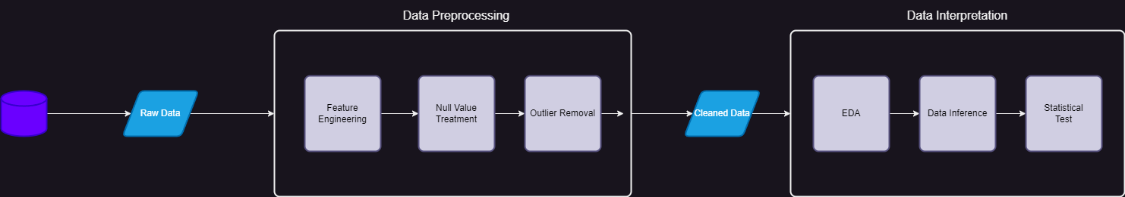
Flow Diagram

Slide 6

Contents
Data Display
Feature Engineering
Null value of Each column and its visualization
Data Cleaning
Imputing Null value using KNN Imputer
Imputing Null value using Decision Tree Imputer
Cleaned Data
EDA
Numeric Analysis
Univariate Analysis
Bivariate Analysis
Outlier Detection and Removal of Outlier
Correlation Analysis

Slide 7
Contents
Asking Questions to Data and Getting Insights from Data
Working with Main dataset
Which brand is popular among user and loved ones based on reviews and ratings?
What is the total worth of price value for Each Brand respective to their Category?
Which size is most preferred by user based on primary category?
Which popular brand owns sephora exclusive and does not have physical shop?
Which new product cost high price and average ratings by user for that product?
Show visualization of total price shared by primary category
Working with reviews dataset
Which product is most recommended by user and its skin tone?
Analyse the Positive feedback count for each brand and other features
Number of ratings given on Each date

Slide 8
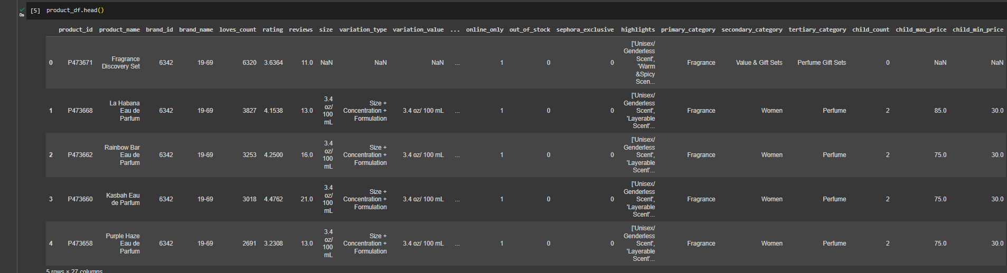
Display Data
Products Data

Slide 9
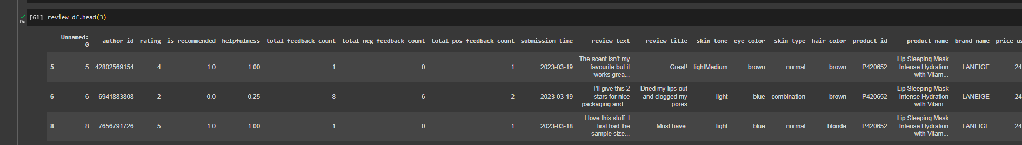
Display Data
Reviews Data

Slide 10
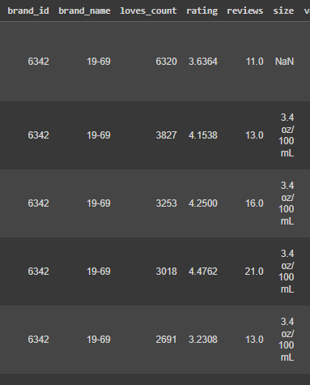
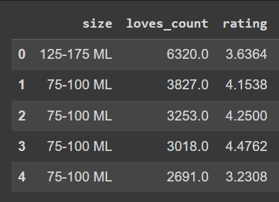
Feature Engineering
The "Size" columns is dirty data which a mixture of numeric and categorical data.
Numeric points has 60% and Categorical points is around 40% of "Size" feature
So, We performed feature engineering process to convert "Size" feature numeric datapoints into bins for categorical points

Slide 11
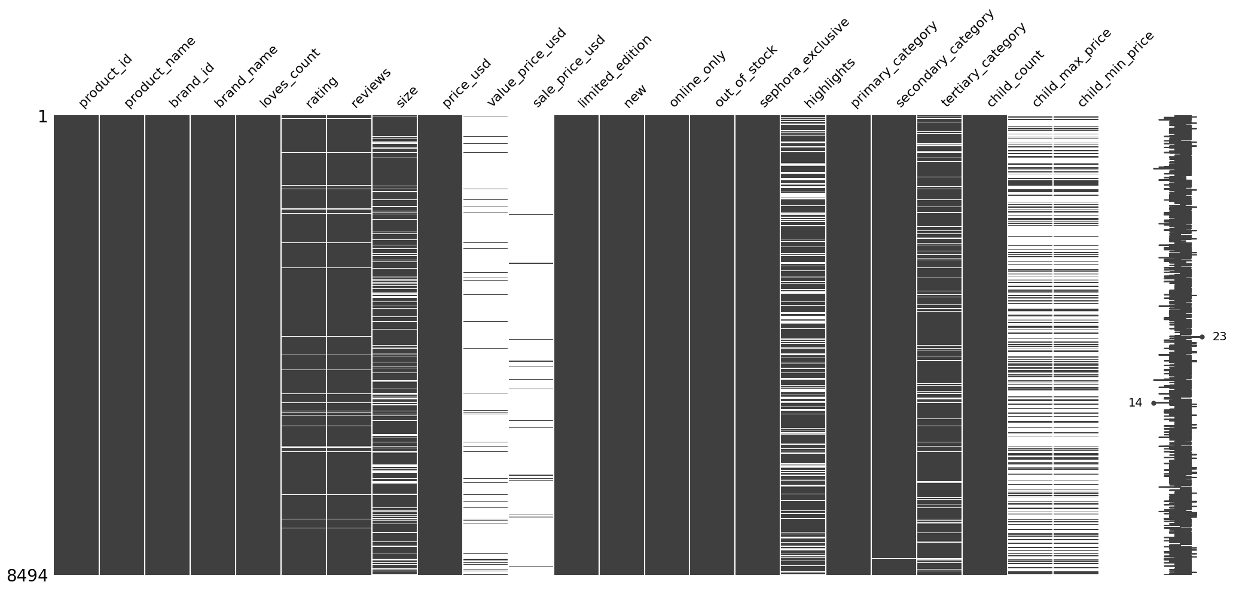
Null value Visualize

Slide 12
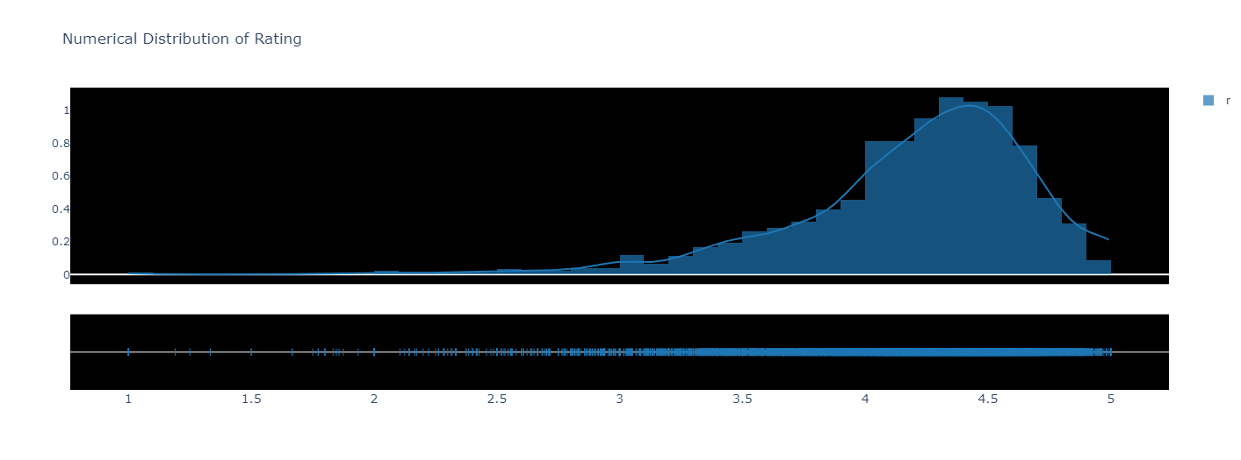
Numerical Analysis

Slide 13
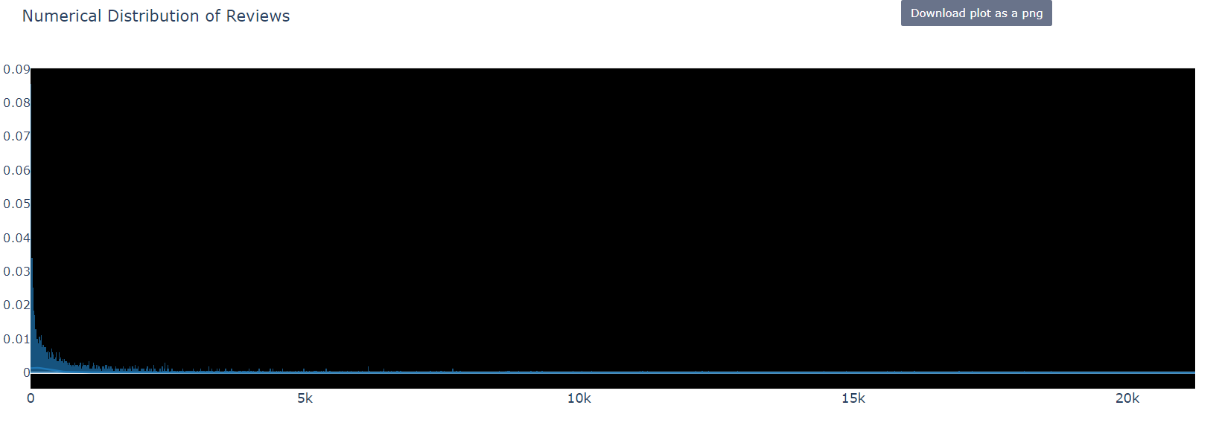
Numerical Analysis

Slide 14
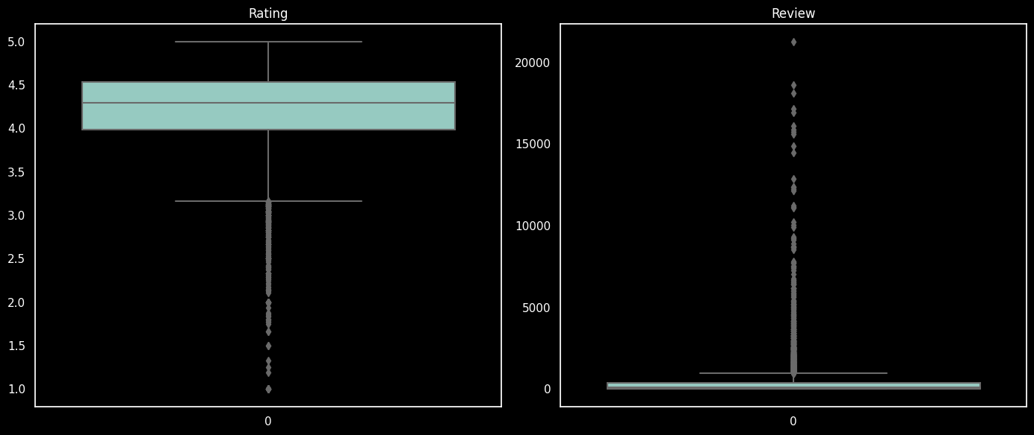
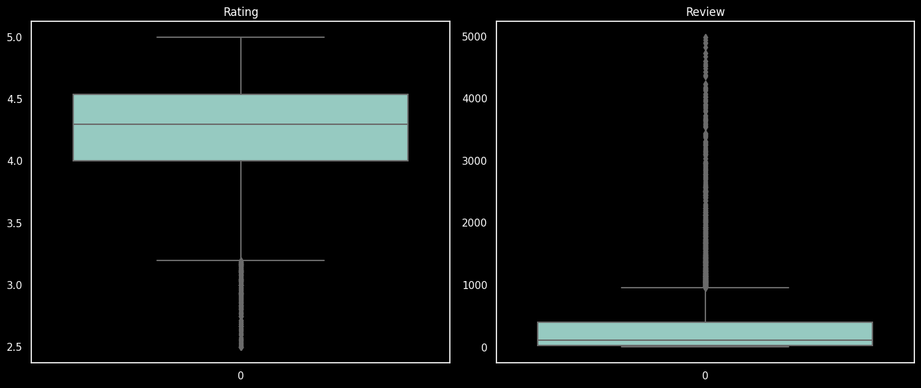
Outlier Detection and Removal
Outlier Detection
Removal of Outlier

Slide 15
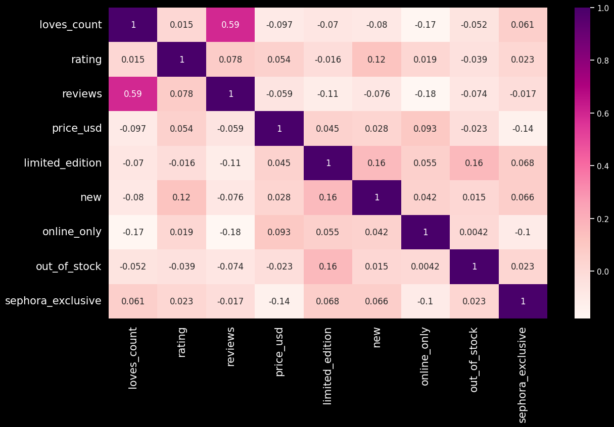
Correlation Analysis

Slide 16
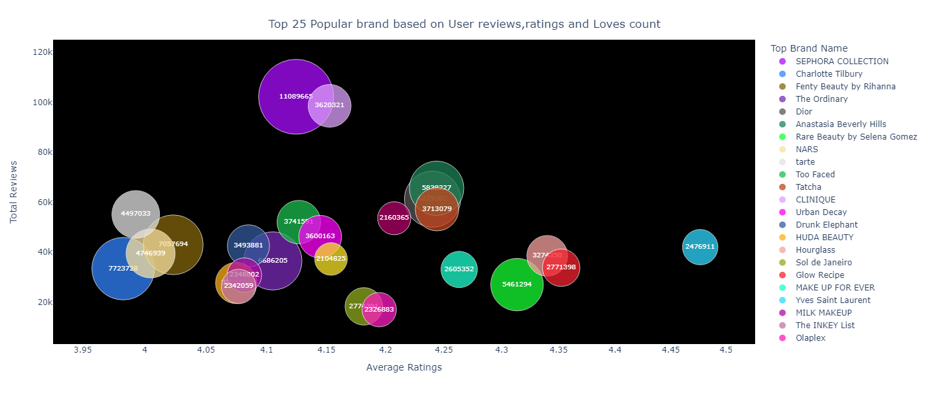
Custom Analysis

Slide 17
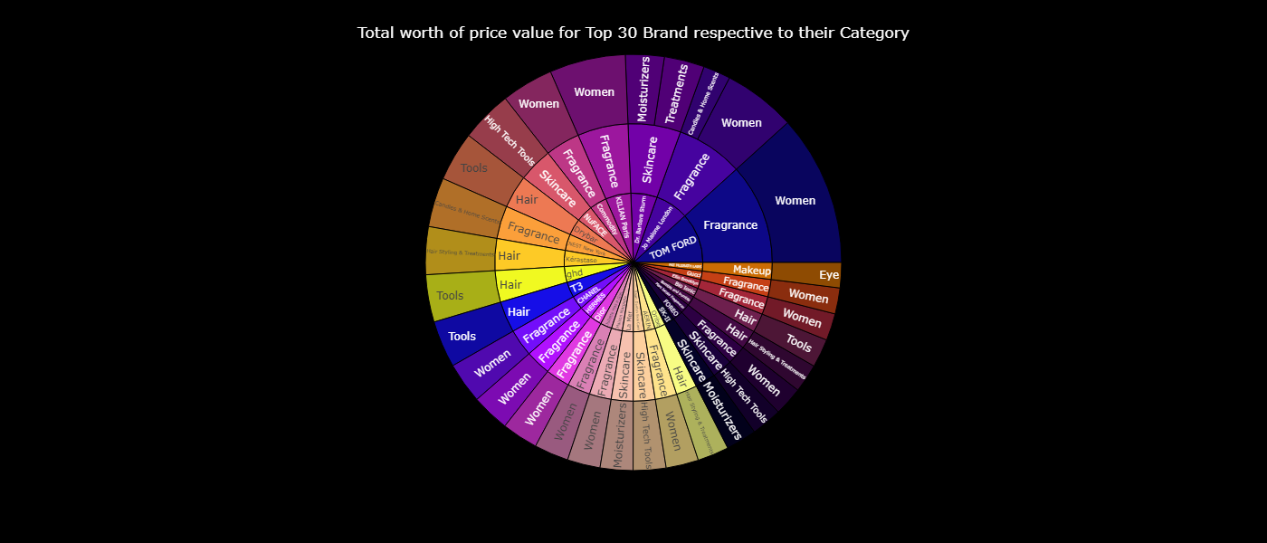
Analysis-2

Slide 18
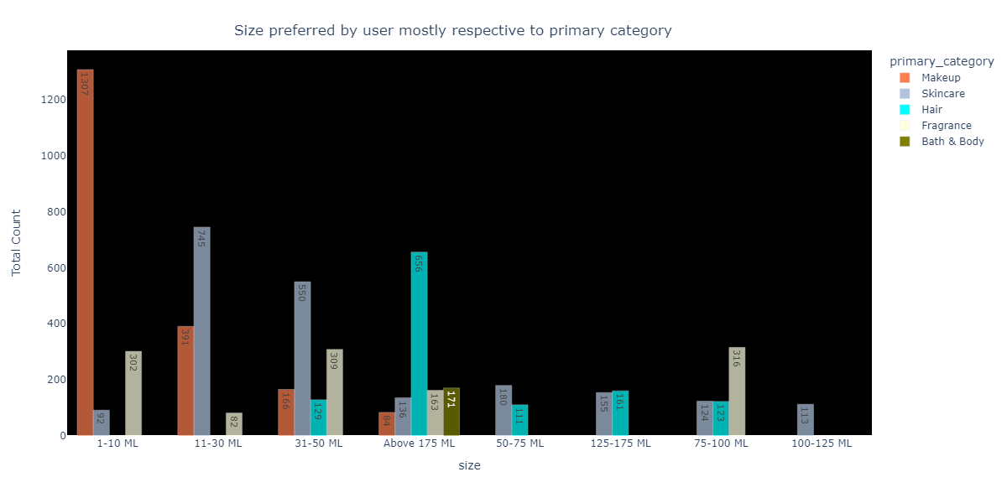
Analysis-3

Slide 19
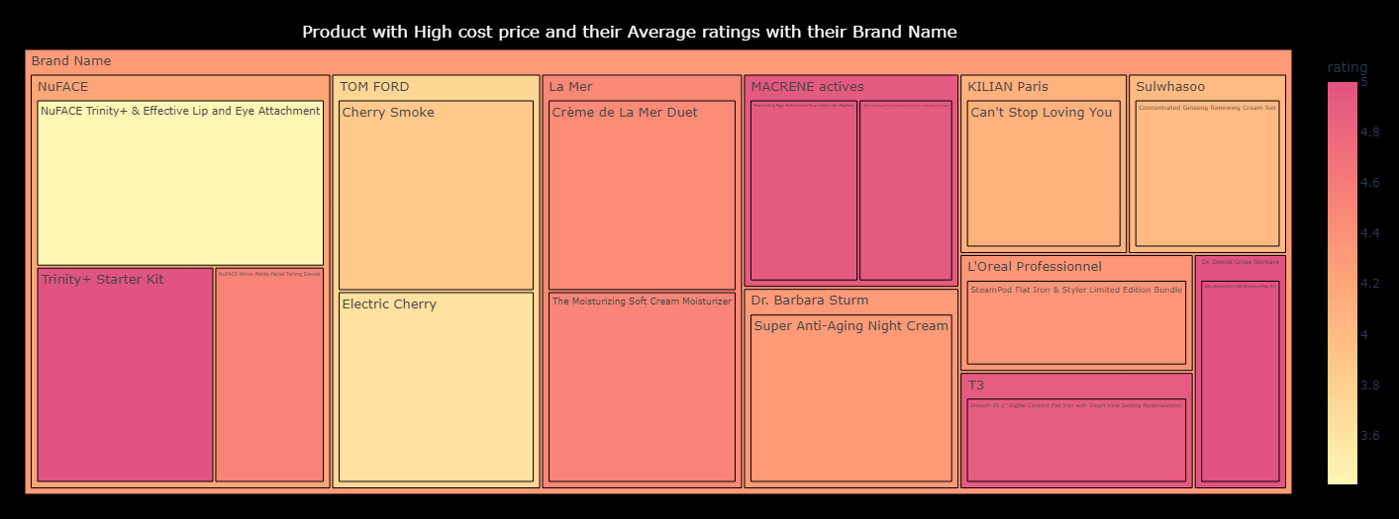
Analysis-4

Slide 20
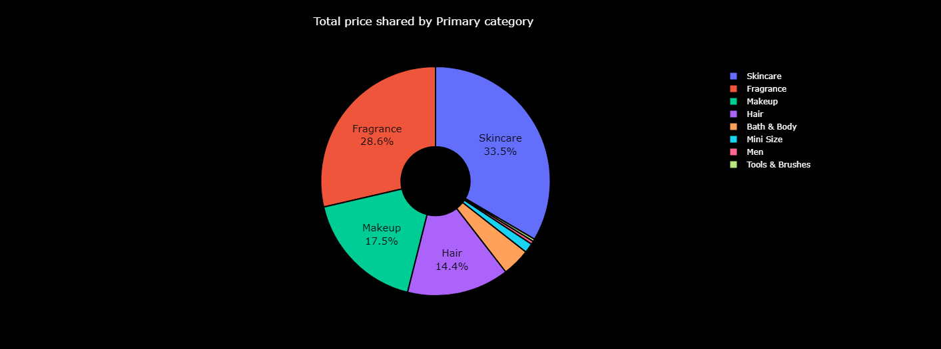
Analysis-5

Slide 21
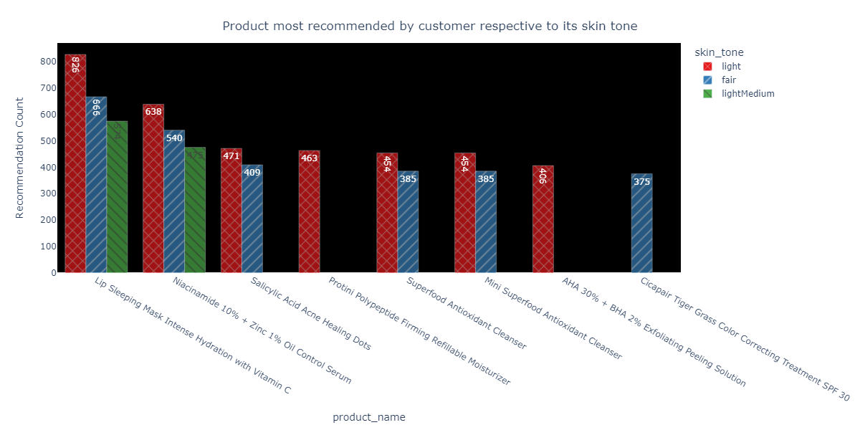
Analysis-6

Slide 22
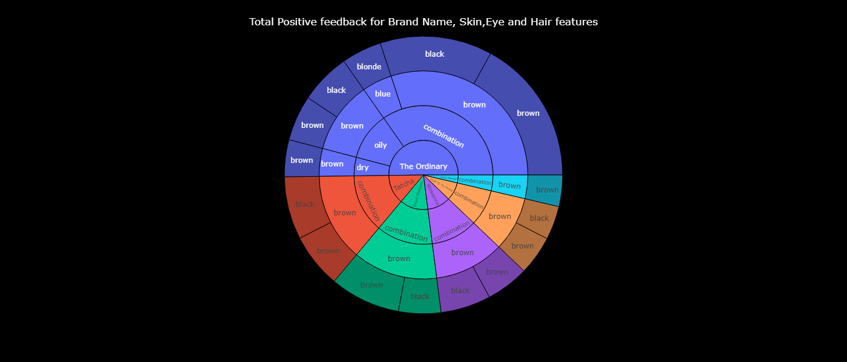
Analysis-7

Slide 23
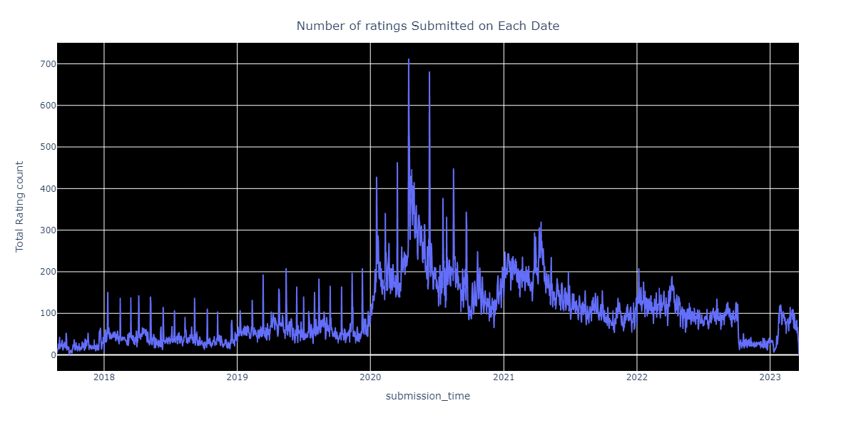
Analysis-8

Slide 24
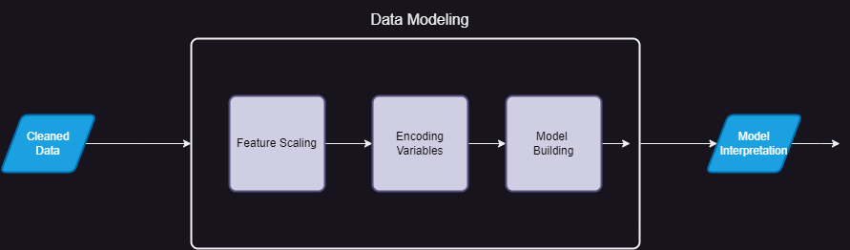
Data Modeling
We build Model to Predict a Price of Product
We Further perform Feature Scaling using Standard Scalar Method
We done Encoding using One Hot Encoding
We build a Model using Linear Regression, Decision Tree Regression, XGBOOST Regression
Once Model is built, we performed data interpretation from model to check its accuracy of model

Slide 25
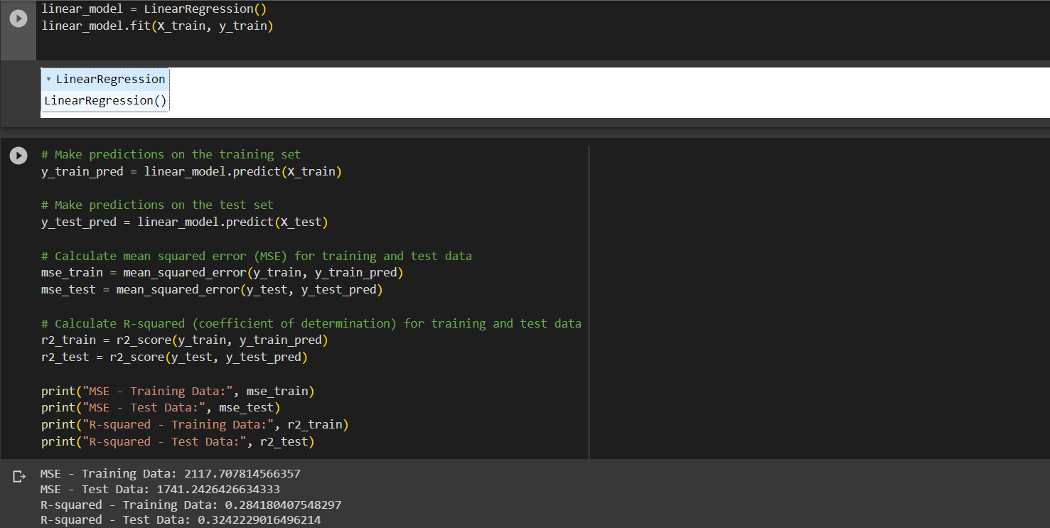
Linear Regression Modeling

Slide 26
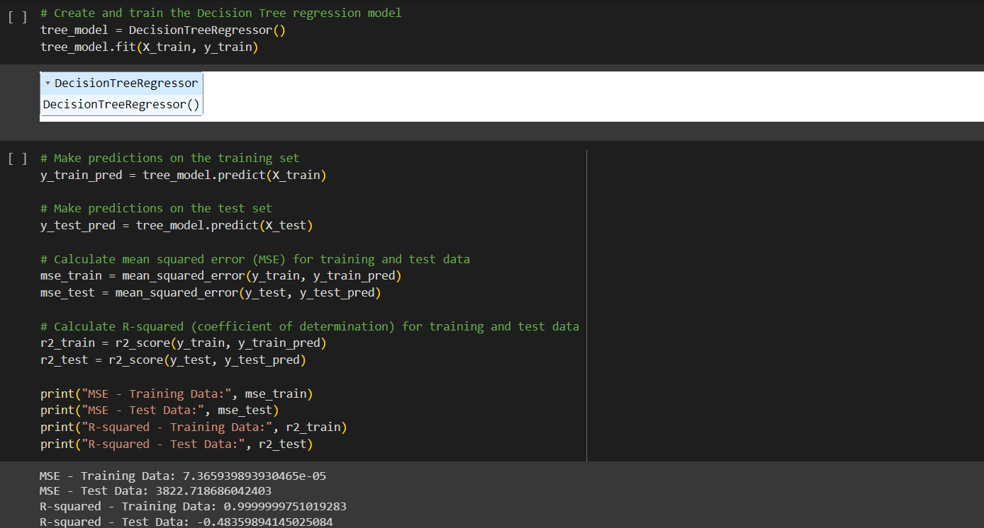
Decision Tree Regression Modeling

Slide 27
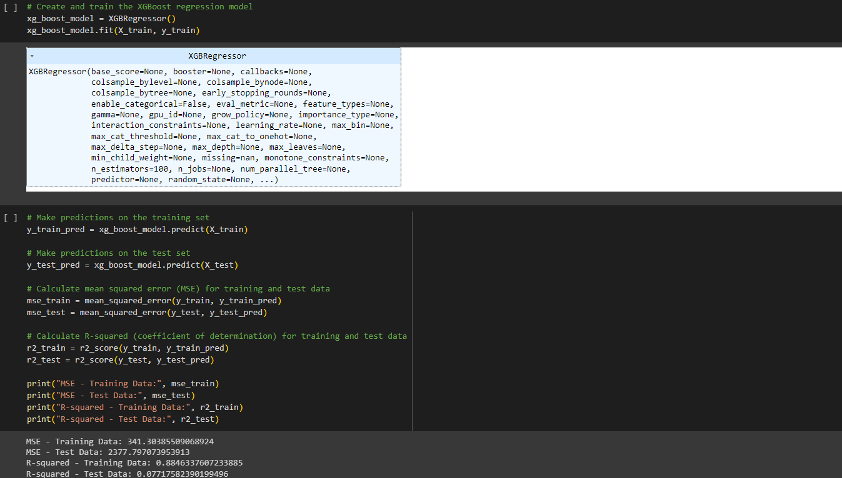
XGBOOST Regression Modeling

Slide 28
Statistical Test
We perform Statistical Test to infer from the data and get the interpretation from it
We used Independent t-test, Chi Squared test, One way Annova, Pearson Correlation Coefficient Test

Slide 29
Independent t-test:
The independent t-test compares the means of two independent groups to determine if there is a significant difference between them
Group1= The ratings of Skincare from Primary category
Group2= The ratings of Makeup from Primary category
Inference Results:
T-statistic: 5.913358400426621
p-value: 3.5848167759449255e-09
There is a significant difference in the mean 'rating' between 'Skincare' and 'Makeup'

Slide 30
Chi-squared test:
The chi-squared test is used to determine if there is a significant association between two categorical variables
Category var1=Primary category
Category var2=Size
Inference Results:
Chi-squared statistic: 9903.90445683496
p-value: 0.0
There is a significant difference in the mean 'rating' between 'Size' and 'Primary category'

Slide 31
One-way Annova:
One-Way ANOVA is used to compare the means of two or more groups to determine if there are any significant differences
Group1= The ratings of Women from Secondary category
Group2= The ratings of Eye from Secondary category
Group3= The ratings of Face from Secondary category
Inference Results:
F-statistic: 29.65235576069065
p-value: 1.9476949111852175e-13
There is a significant difference in the mean 'rating' among the 'Women', 'Eye', and 'Face' categories.

Slide 32
Pearson Correlation Coefficient:
The Pearson correlation coefficient measures the linear relationship between two continuous variables. It assesses how strongly they are linearly correlated
Numerical var1=Loves Count
Numerical var2=Reviews
Inference Results:
Pearson Correlation Coefficient: 0.6832004791644654
p-value: 0.0
There is a strong linear relationship between 'loves_count' and 'reviews'

Slide 33




Thankyou

